Slide 1
Analytical instrumentation Section-2, Ppt-22

Slide 2
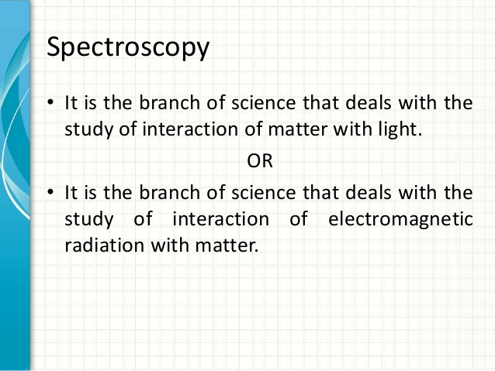

Slide 3
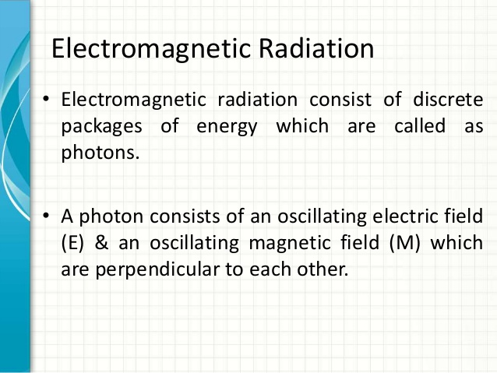

Slide 4
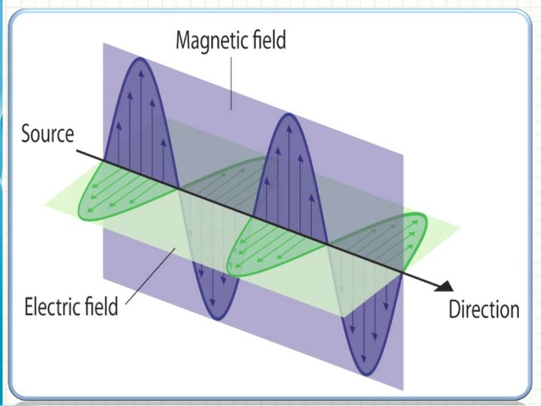

Slide 5
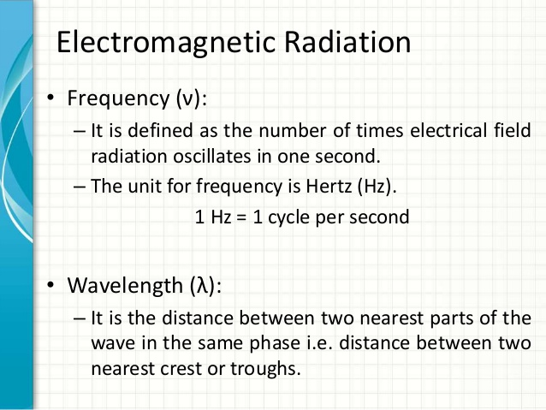

Slide 6
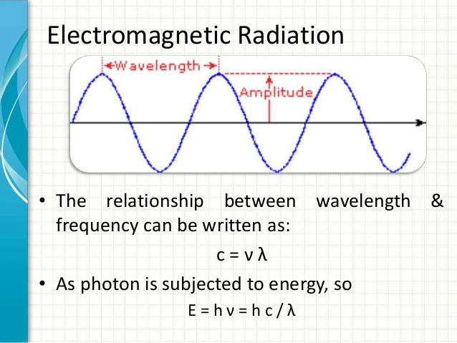

Slide 7
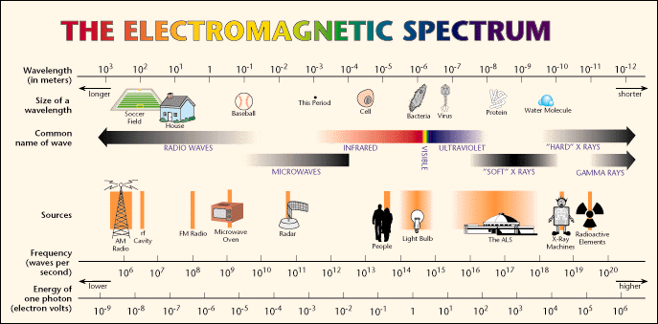

Slide 8
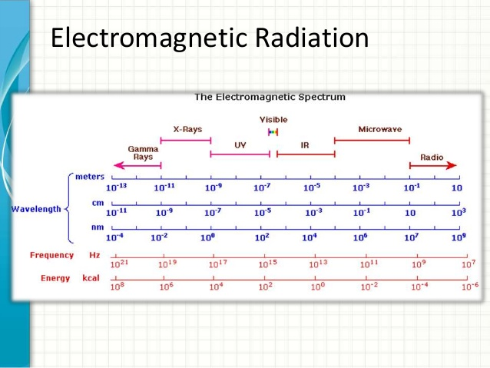

Slide 9
Type of Radiation | Frequency Range (Hz) | Wavelength Range | Type of Transition
gamma-rays | 10²⁰-10²⁴ | <1 pm | nuclear
X-rays | 10¹⁷-10²⁰ | 1 nm-1 pm | inner electron
ultraviolet | 10¹⁵-10¹⁷ | 400 nm-1 nm | outer electron
visible | 4-7.5x10¹⁴ | 750 nm-400 nm | outer electron
near-infrared | 1x10¹⁴-4x10¹⁴ | 2.5 µm-750 nm | outer electron molecular vibrations
infrared | 10¹³-10¹⁴ | 25 µm-2.5 µm | molecular vibrations
microwaves | 3x10¹¹-10¹³ | 1 mm-25 µm | molecular rotations, electron spin flips*
radio waves | <3x10¹¹ | >1 mm | nuclear spin flips*

Slide 10
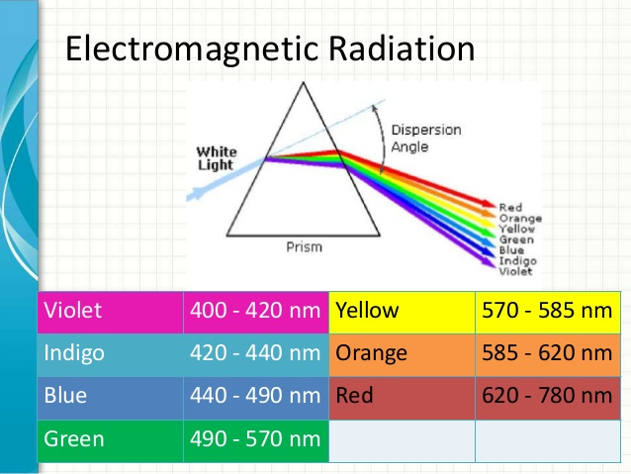

Slide 11
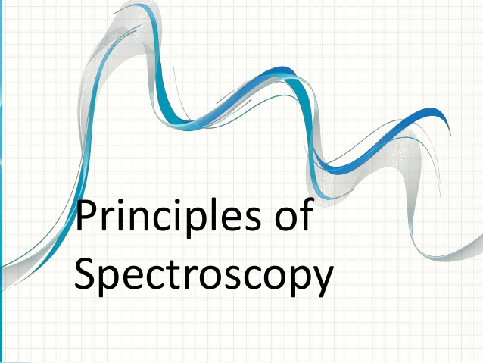

Slide 12
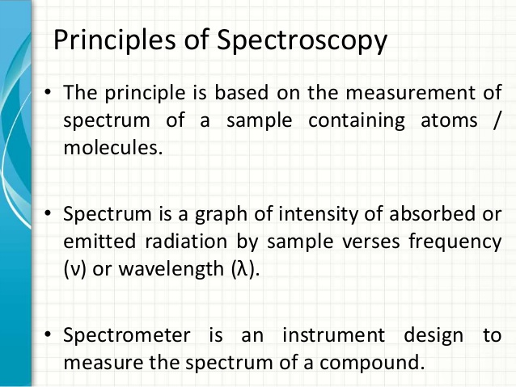

Slide 13
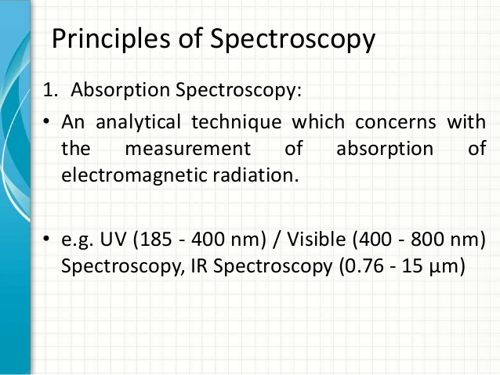

Slide 14
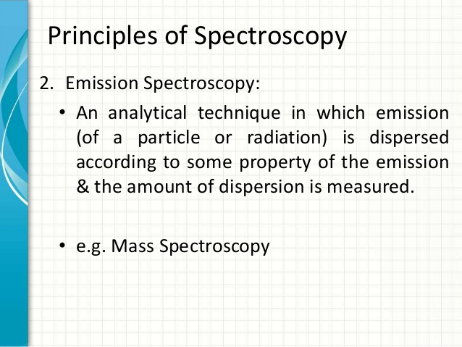

Slide 15
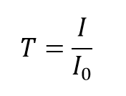
transmittance T
T, the percentage of light that goes through the sample)
The transmittance, T, of the solution is defined as the ratio of the transmitted intensity, I, over the incident intensity, I₀:

Slide 16
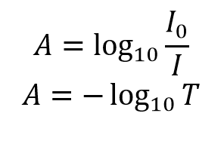
Absorbance (Abs, representing the amount of light absorbed by the sample)

Slide 17
In the example above, a single sheet of the colored material transmits 70% of the light:
I/I_{o}= 0.70 ; T = 70% ; Abs = - log₁₀(0.70)= 0.155
A second sheet transmits 70% of the light it receives, or 49% (0.70 x 70%) of the original light:
I/I_{o}= 0.49 ; T = 49% ; Abs = - log₁₀(0.49)= 0.310
The third sheet transmits 70% of the light it receives, or 34.3 % (0.70 x 49%) of the original light:
I/I_{o}= 0.343 ; T = 34.3% ; Abs = - log₁₀(0.343)= 0.465

Slide 18
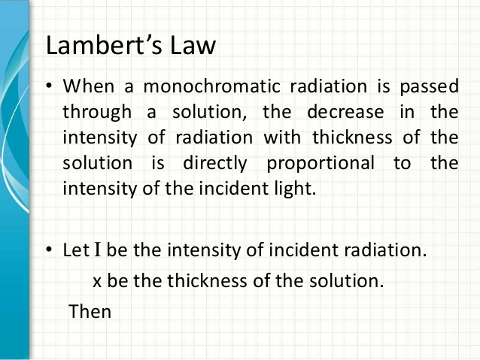

Slide 19
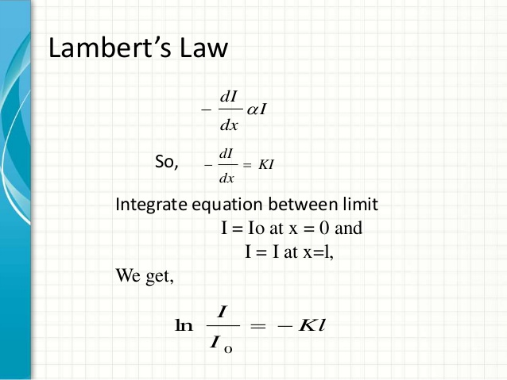

Slide 20
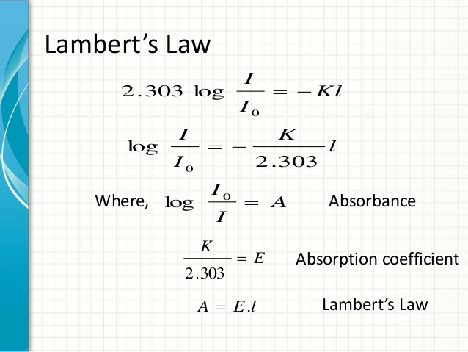

Slide 21
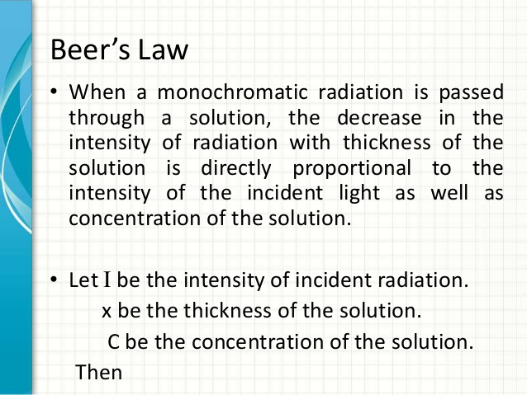

Slide 22
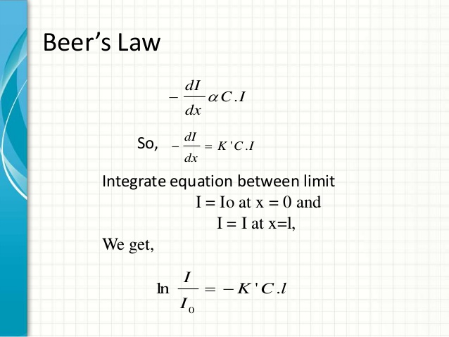

Slide 23
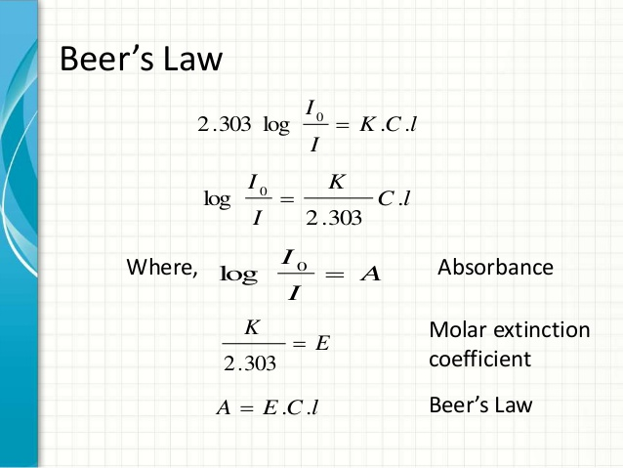

Slide 24
Thank you

